Slide 1
Improving developer experience with .NET Aspire
Anthony Simmon

Slide 2

About me
Staff software developer at Workleap
.NET developer for 13 years
.NET Aspire enthusiast and blogger
Endorsed by the .NET Aspire team

Slide 3
Onboarding challenges
It gets ugly quick

Slide 4
The costs are real
Companies lose billions annually due to inefficient onboarding and delayed productivity

Slide 5
What if… we could hit F5 and hit the ground running?

Slide 6

Get started
To build
To deploy
Open-source
Templates
Integrations
Service discovery
Developer dashboard
Logs, metrics,
distributed traces
Single command run
App topology in C#
Cloud deployment

Slide 7
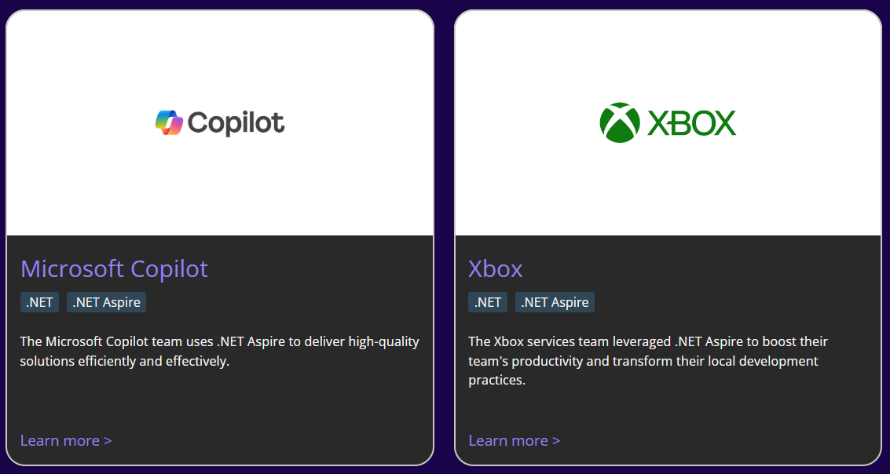
Who’s using .NET Aspire?

Slide 8
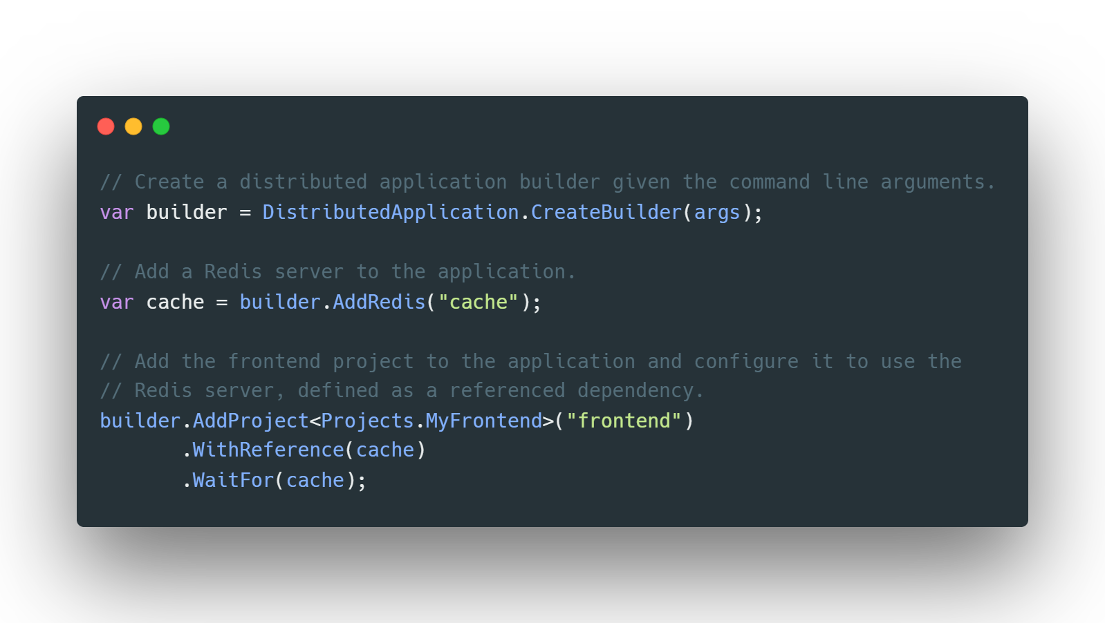

Slide 9
New features
Improved developer experience

Slide 10
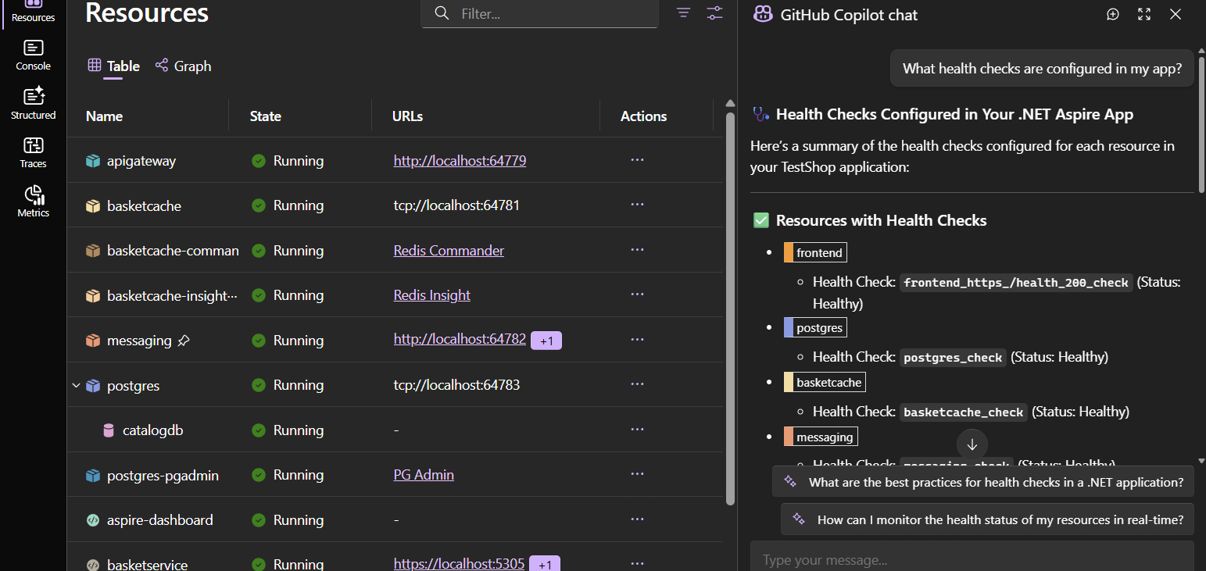
GitHub Copilot

Slide 11
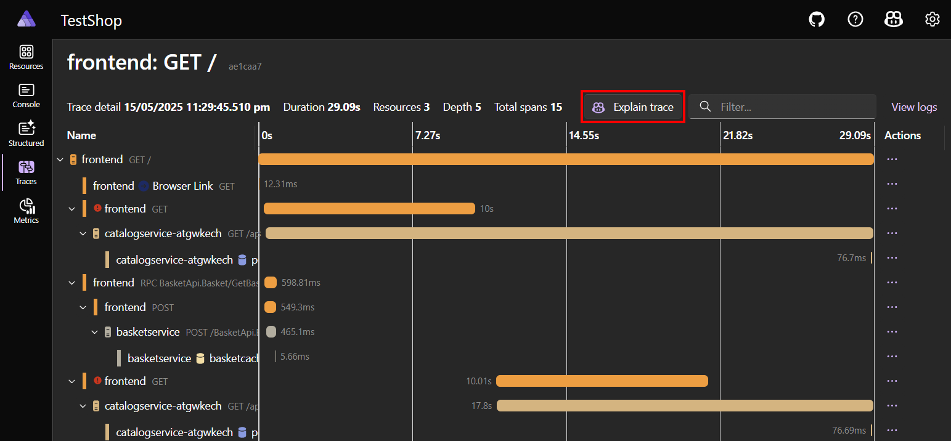
GitHub Copilot

Slide 12
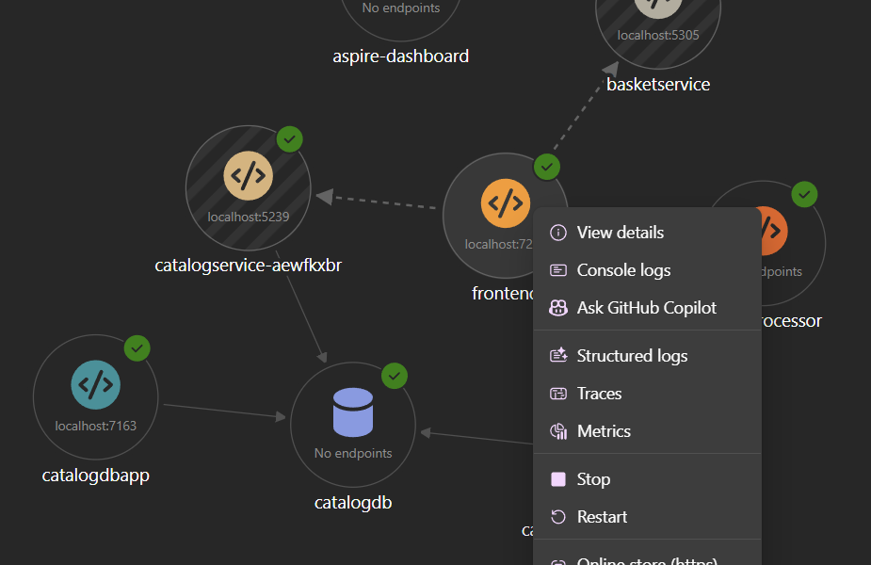
Interactive dynamic resource graph

Slide 13
Demo
A complex distributed system running in minutes

Slide 14
Extensibility
Model anything your app needs

Slide 15
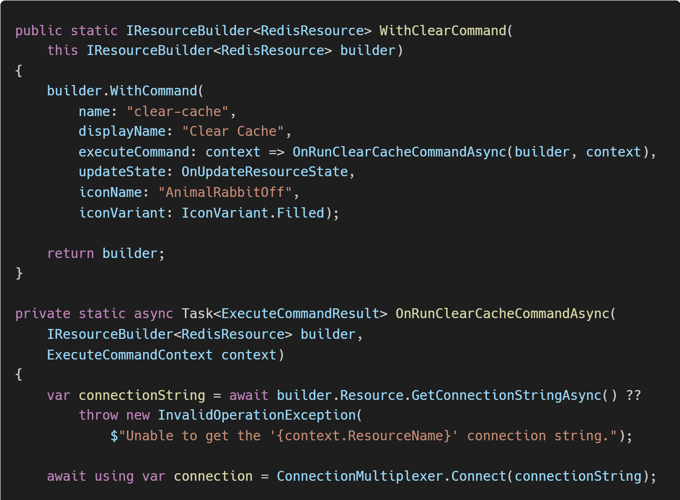
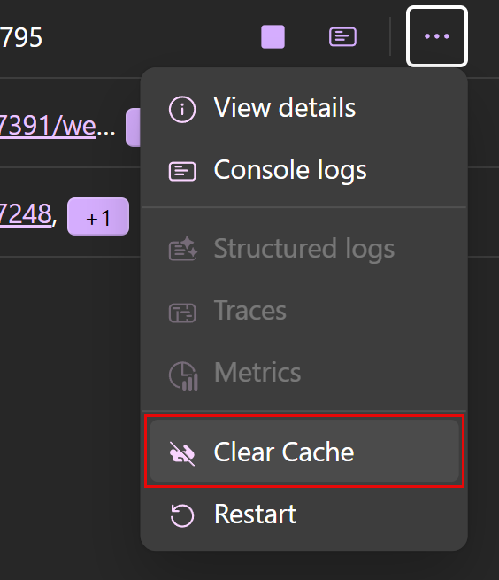
Custom commands

Slide 16
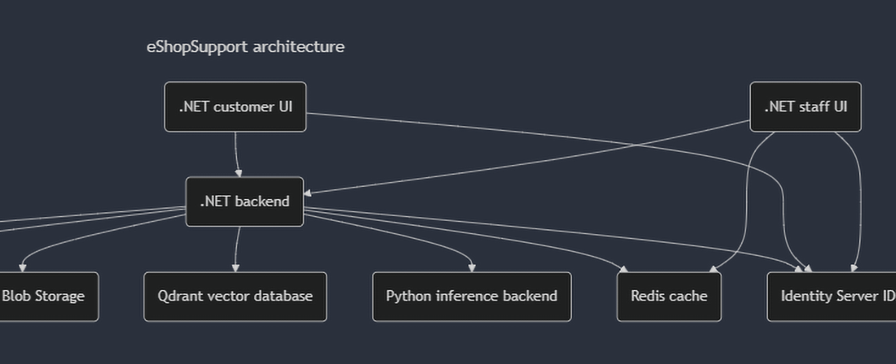
Static architecture diagrams

Slide 17
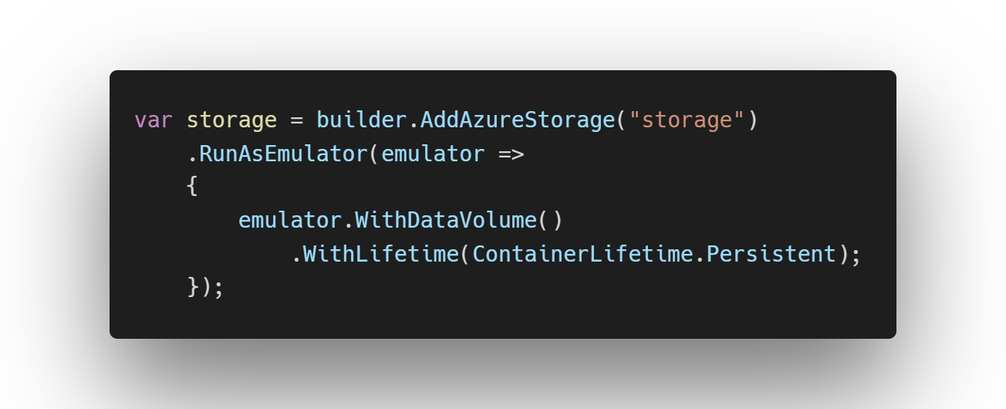
Persistent containers

Slide 18
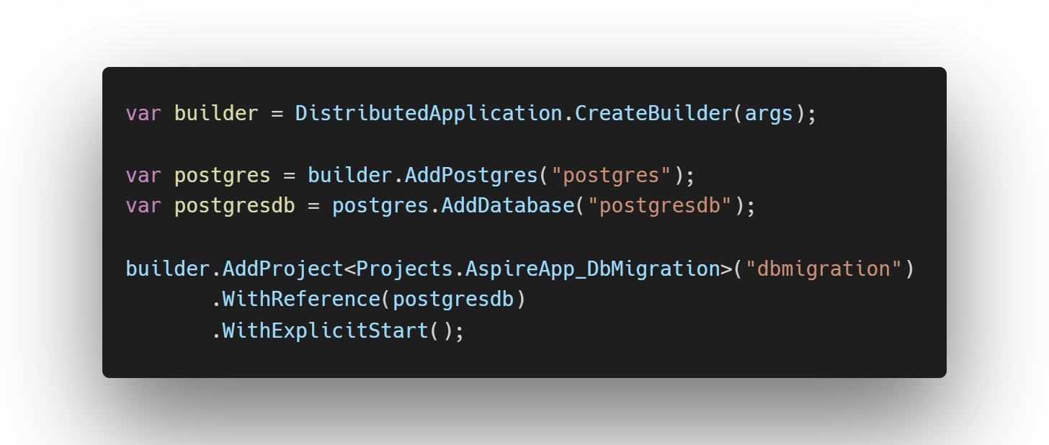
Explicit resource startup

Slide 19

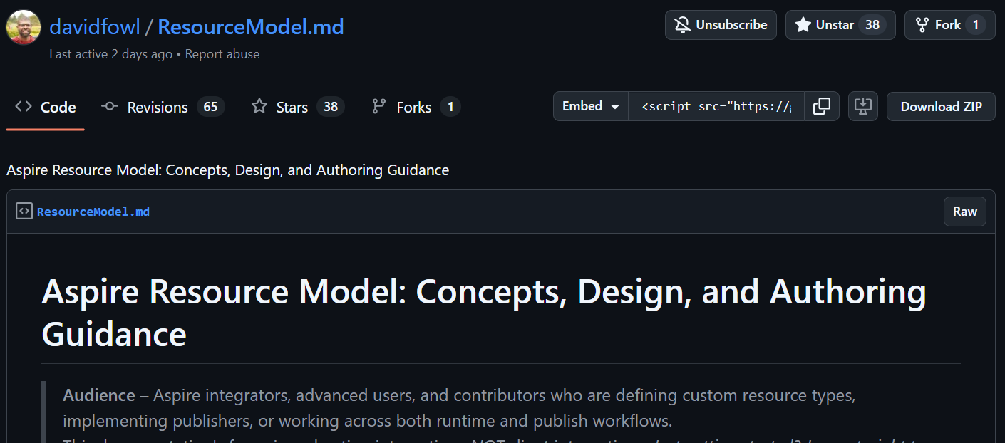
Custom resources

Slide 20
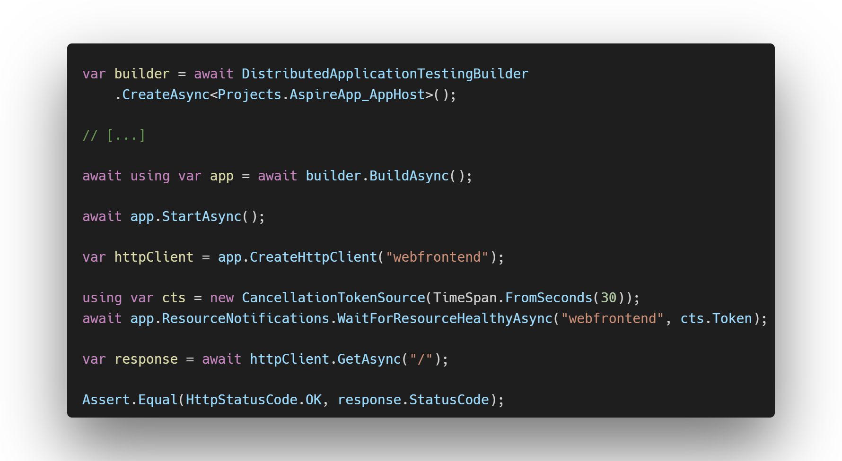
Explicit resource startup

Slide 21
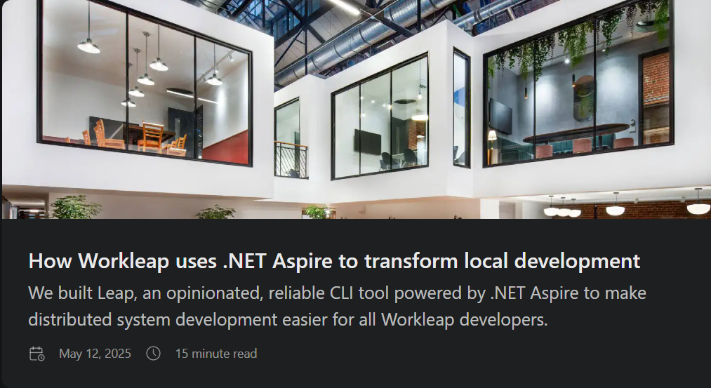
Imagination is the limit

Slide 22
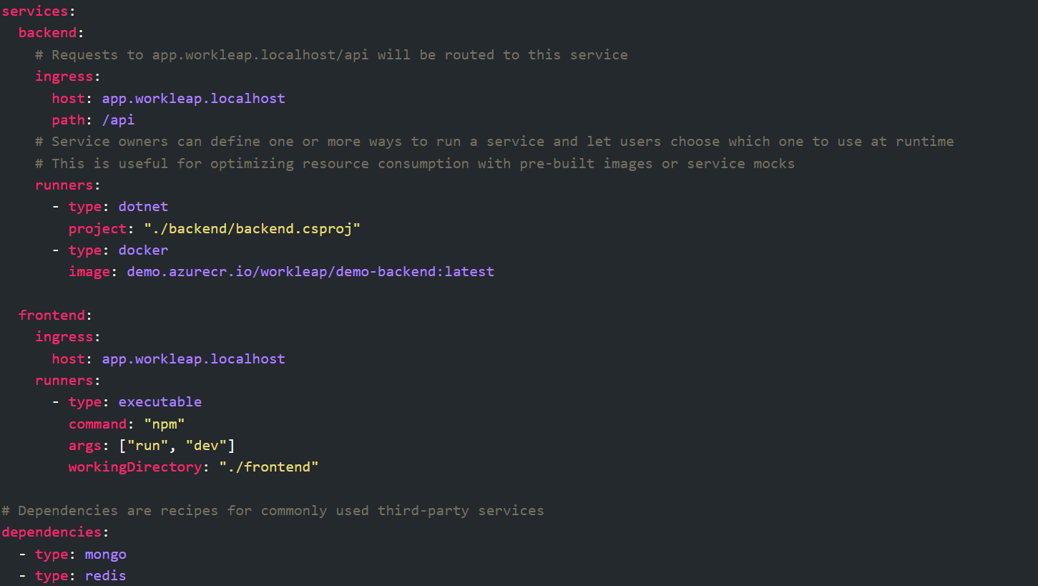
.NET Aspire at Workleap

Slide 23
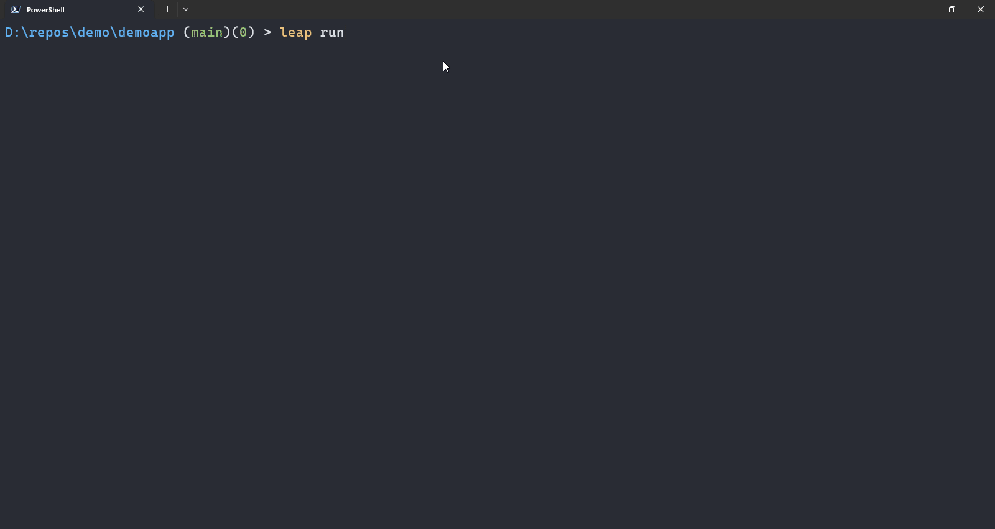
.NET Aspire at Workleap

Slide 24
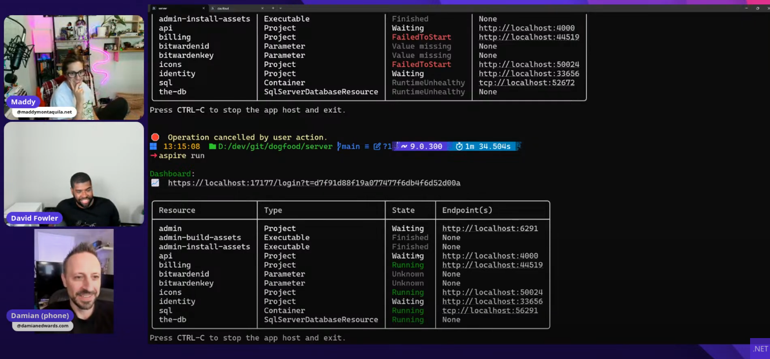
Adding .NET Aspire to Bitwarden

Slide 25
What’s next
.NET Aspire SDK in other languages
Aspire becomes a “standalone” thing
Abstracting CI / CD
Persistent app host across runs

Slide 26
Thank you!
anthonysimmon.com
x.com/asimmon971
bsky.app/profile/anthonysimmon.com

